Slide 1
How to be more independent: Morning and evening routines
Comarniceanu Alexandra, BCBA

Slide 2
As a parent, getting your child to go through all the steps of a morning or evening routine can be difficult, especially if your target is for him/her to do them independently.
Therefore, the target of this presentation is to find strategies that can help them achieve that goal.

Slide 3
First of all, make a list with all the steps in the morning/bedtime routine.
Here is an example for the morning routine: go to the toilet, wash hands and face, get dressed, have breakfast, brush teeth and make the bed.
Next, we can have two different scenarios. In the first one, your child is able to perform each of those tasks independently, but he does not transition from one to another, therefore he is not able to do the routine without your help.

Slide 4
If this is the case, you can use a visual schedule in order to help him.
The schedule should contain pictures of the activities you want him to do, in the order he is suppose to do them. If he can read, you can add writing to the pictures, or maybe you can have a written schedule, without any pictures.

Slide 5
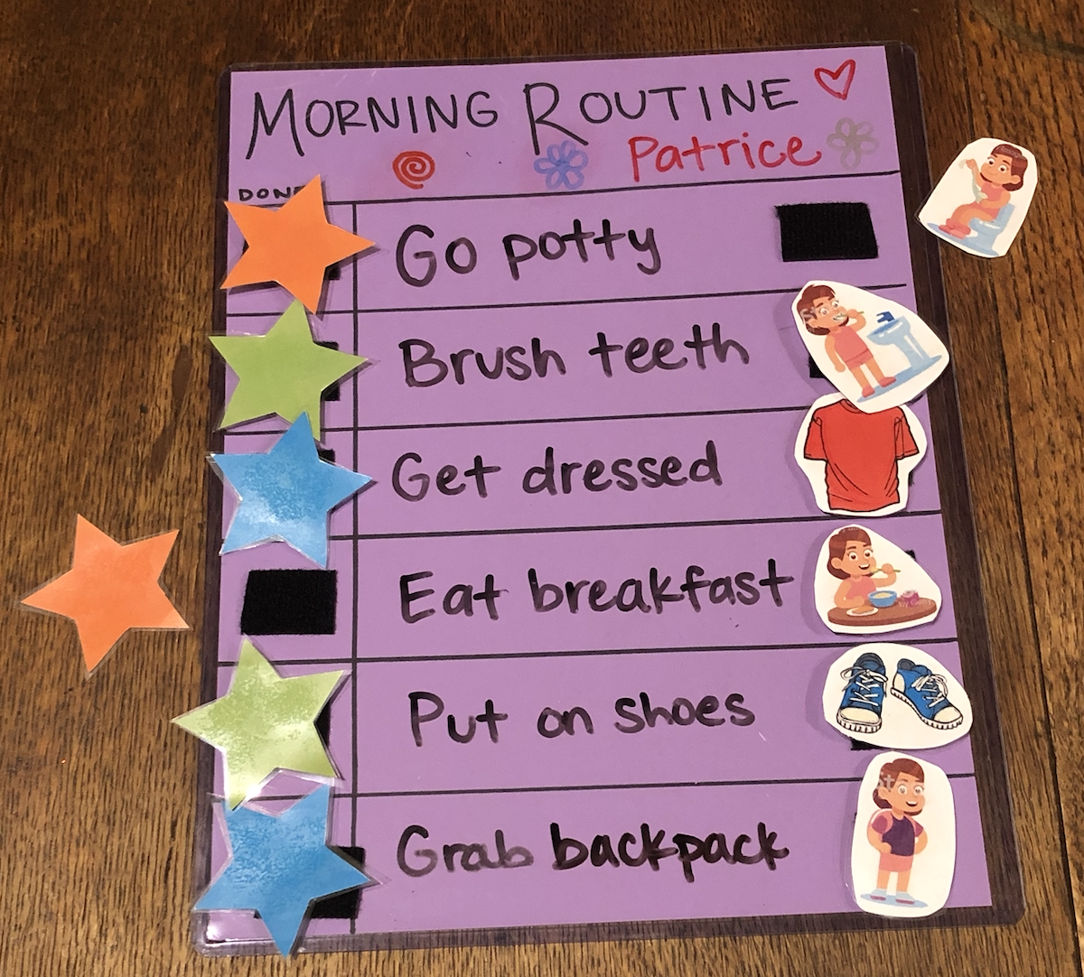

Slide 6
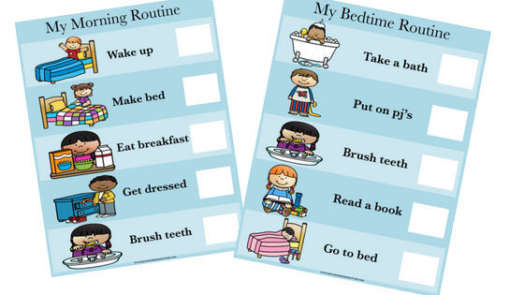

Slide 7
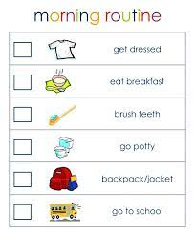

Slide 8
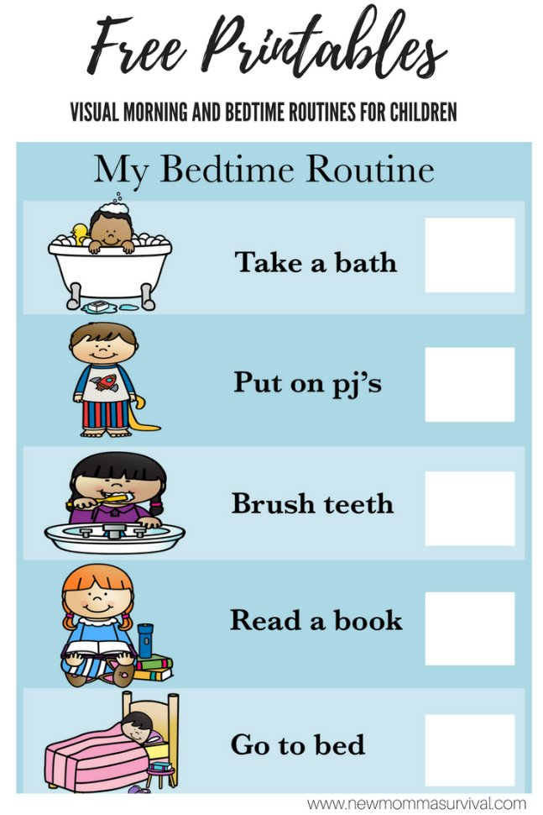

Slide 9
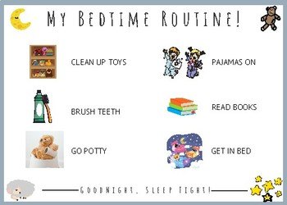

Slide 10
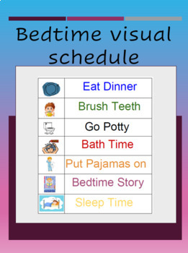

Slide 11
When it is time for each of those two routines, you take the child to the visual schedule (place it on a door, or in another place where the child can easily see it), and guide him to look at all the activities.
After that, guide him to go back to the first picture, look at it and do the activity.
After he finishes it, guide him to come back to the visual schedule and either take the picture down or put a symbol next to it, to show that he has done it.

Slide 12
Then he should look at the second picture, do that activity and take the picture down/put a symbol next to it.
This sequence is continued until all the activities are done.
At this point, you should reinforce your child’s behavior for completing the routine.
The reinforcer should be motivating enough so that the child will finish the whole routine.
If necessary, in the beginning we can reinforce each activity.

Slide 13
Because our target is that the child moves independently from one step to another and perform the routine without any guidance (including vocal guidance), it is important to fade out initial guidance, gradually.

Slide 14
The second scenario targets the situation in which the child not only needs help to transition from one activity to another during the routine, but also needs help with performing the activities themselves.
In this case, the initial focus should be to teach the child to perform each activity correctly and independently and only after that, to teach him to perform them in an independent sequence, as previously discussed.

Slide 15
To be able to do that we need a task analysis, which is a description of the steps that are necessary in order to perform those targets.
In order to design a task analysis you can perform the activity yourself and write down all the steps you do. Or you can observe the child and notice what steps he is already doing and in which order, and start from there. Or you could ask someone else to perform the task (someone who is skilled) and write down the steps. Or even combine those different methods.

Slide 16
Date/teacher Steps
1.Roll up sleeves
2. Turn on water
3.Place hands under water
4.Take the soap
5. Rub the soap between palms
6.Put the soap back
7.Rub palms together (3 sec)
8.Rub back of right hand (3sec)

Slide 17
9. Rub back of left hand (3sec)
10.Rinse hands
11. Turn off water
12. Find hanging cloth towel
13. Dry palms of both hands
14.Dry back of right hand
15. Dry back of left hand
16.Put towel back

Slide 18
Once you have the steps, it’s time to start teaching them.
There are three methods we can use, in order to do that: backward chaining, forward chaining and total task.
I will describe all of them so that you will have a better understanding and choose the one that suits your child the best.

Slide 19
Total task means teaching all the steps in the chain, in the order they are normally done, and helping the child with each step where help is necessary.
It is important to reinforce this activity (initially, we can use more reinforcement throughout the chain if necessary and decrease it gradually, so that in the end we can offer reinforcement only after the whole sequence is completed).

Slide 20
Forward chaining means teaching the sequence in the correct order, but focusing only on the first step, and having the adult complete the rest.
Reinforcement will be offered after this first step.
As soon as the child learns to correctly perform the first step, we will move on to the second one, so that he will have to do both steps (and receive reinforcement), and the adult will complete the rest.
The sequence will continue like this, until the child will learn to perform it independently.

Slide 21
Backward chaining means that the adult will perform all the steps in the sequence except for the last one, which will be performed by the child. He will receive reinforcement after this last step.
As soon as the child learns to perform this step independently, the adult will perform all the steps in the sequence except the last two, which will be performed by the child.
The sequence will continue like this until the child will learn to perform the whole sequence independently.

Slide 22
After each activity is taught, you can focus on connecting them into a sequence and work on transition and the completion of the whole routine.

